Slide 1
Department MARGINAL WORKERS

Slide 2
Instructions
Marginal workers are individuals who are employed in low-productivity and low-paying jobs, often in the informal sector. They may have irregular or part-time employment and limited job security. This term is commonly used in the context of labor economics and demographic studies to describe a segment of the workforce facing economic vulnerability.

Slide 3
Employee Management System
The task is to create a Database-driven Employee Management System in Python that will store the information in the MySQL Database. The scr
Getting Started
For creating the Employee Management System in Python that uses MySQL database we need to connect Python with MySQL.
For making a connection we need to install mysqlconnector which can be done by writing the following command in the command prompt on Windows.

Slide 4
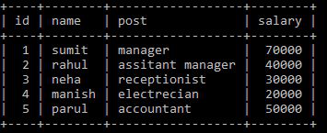
Coding
Import mysql.connector con = mysql.connector.connect( host=“localhost”, user=“root”,
Table in Use:

Slide 5
Check Employee Function
The check employee function takes employee id as a parameter and checks whether any employee with given id exists in the employee details record or not. For checking this it uses function which counts the number of rows that match with given details. It is a utility function, and we will see its use in later operations like Add employee function, etc
The idea is that we keep all the information about the Employee in the above table and manipulate the table whenever required.
So now we will look at the working of each operation in detail.

Slide 6
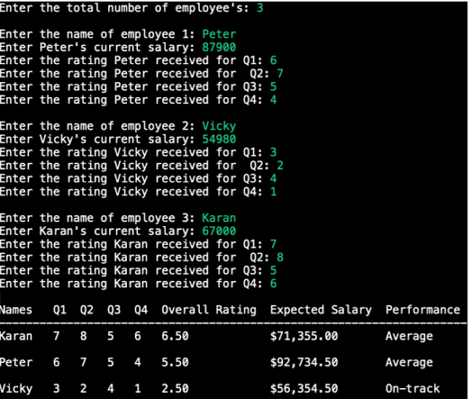
Program

Slide 7
Promote Employee Function
Promote Employee Function
The Promote Employee function will ask for the Employee Id and uses the check employee function to check whether the employee to be Promoted exist in our record or not if employee details exist then it will ask for the amount by which his salary is to be increased. After getting the valid details it increases the salary of the employee with the given id by the given amount.
The Menu function displays the menu to the user and asks the user to enter his choice for performing operations like Add employee, Remove employee, etc

Slide 8


